Slide 1
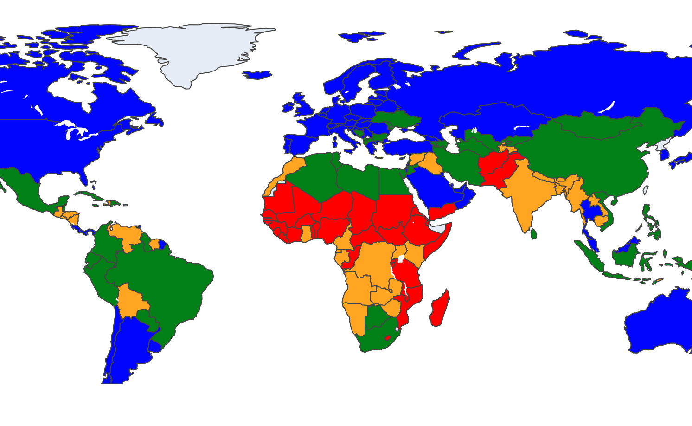
DABN14-Project 2:
Clustering Countries
12.12.25
Clustering countries based on wealth and health metrics
Erik Broms & William Nordansjö

Slide 2
Agenda
DABN14-Project 2
1.
Introduction, Data & Research Question
2.
Human Development Index
3.
Models & Theory
4.
Results & Evaluation
5.
Conclusion

Slide 3
Agenda
DABN14-Project 2
1.
Introduction, Data & Research Question
2.
Human Development Index
3.
Models & Theory
4.
Results & Evaluation
5.
Conclusion

Slide 4
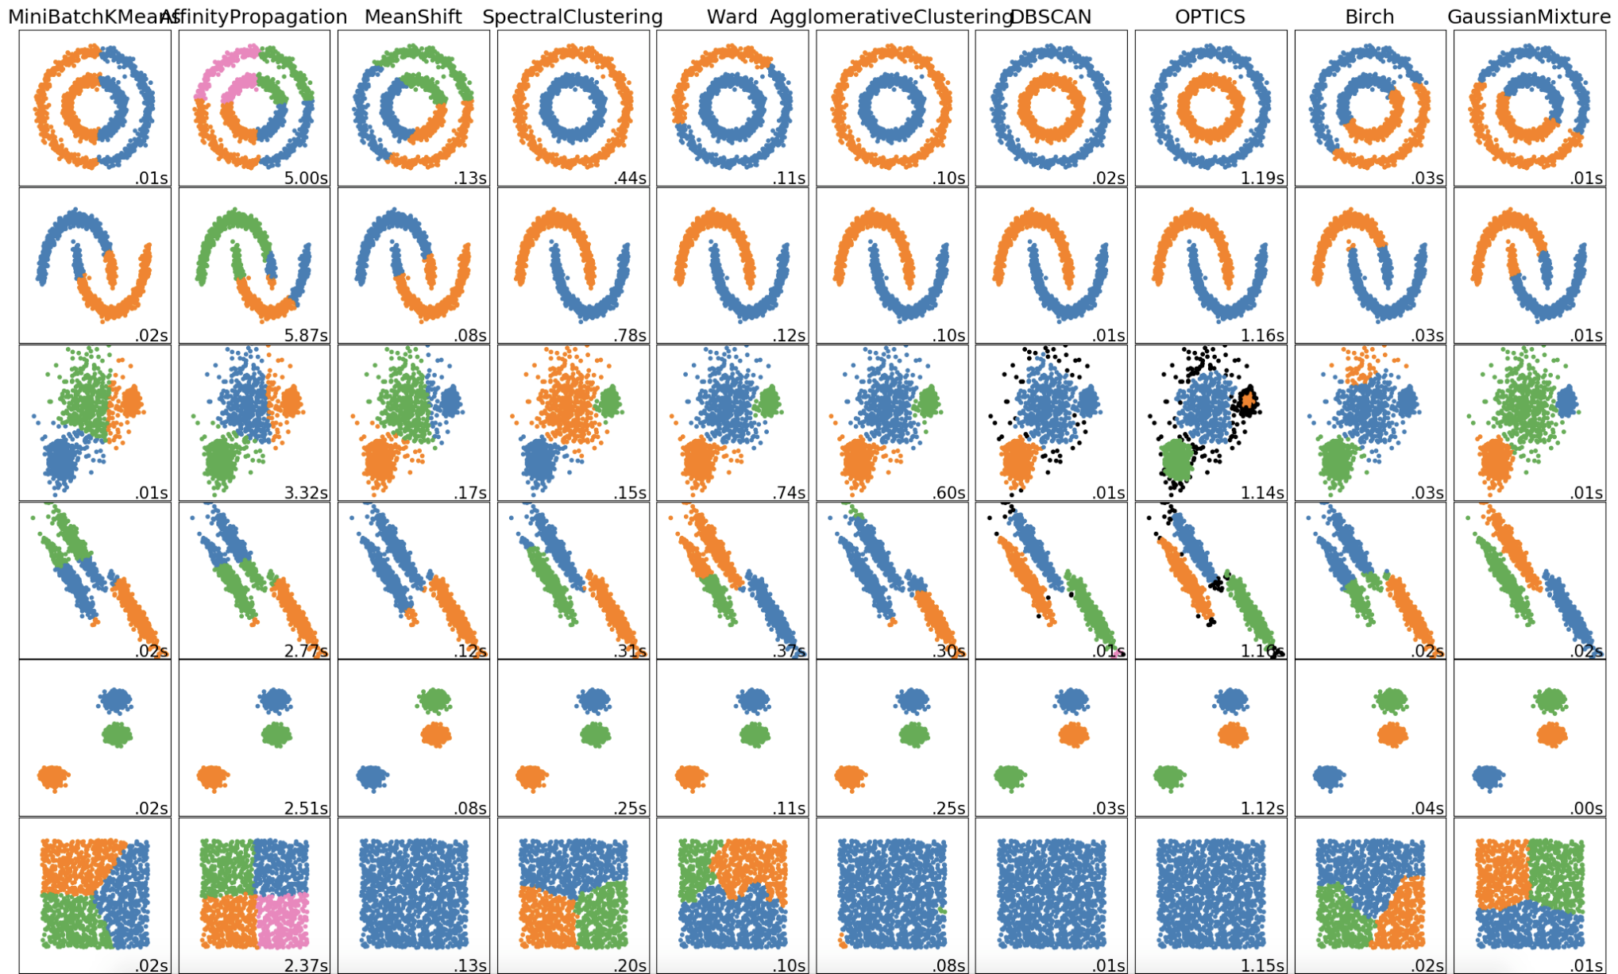
Introduction
Introduction, Data & Research Question
DABN14-Project 2
Clustering:
Letting the data tell the tale
What are we looking for?
What methods are we going to use?
Previous research:
Countries, health and wealth
Clustering

Slide 5
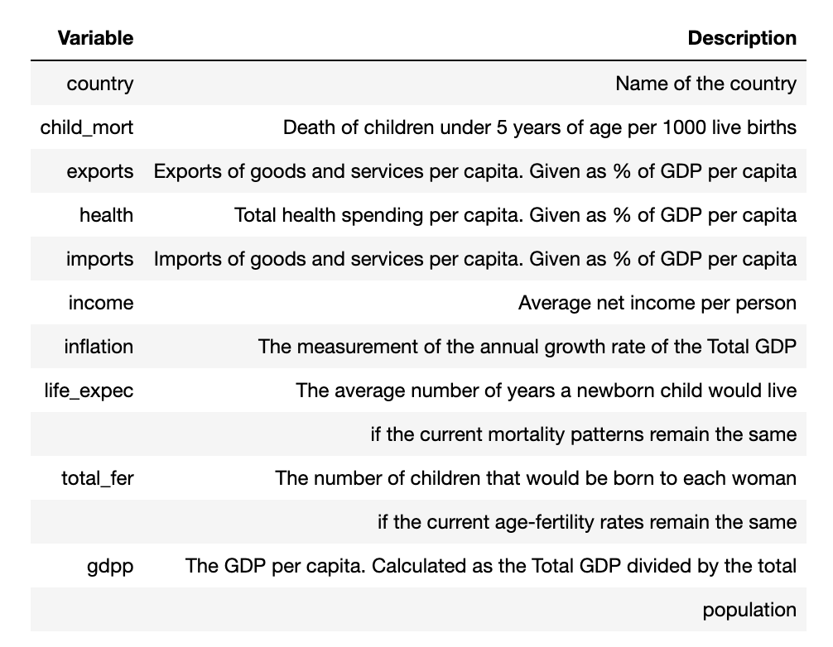
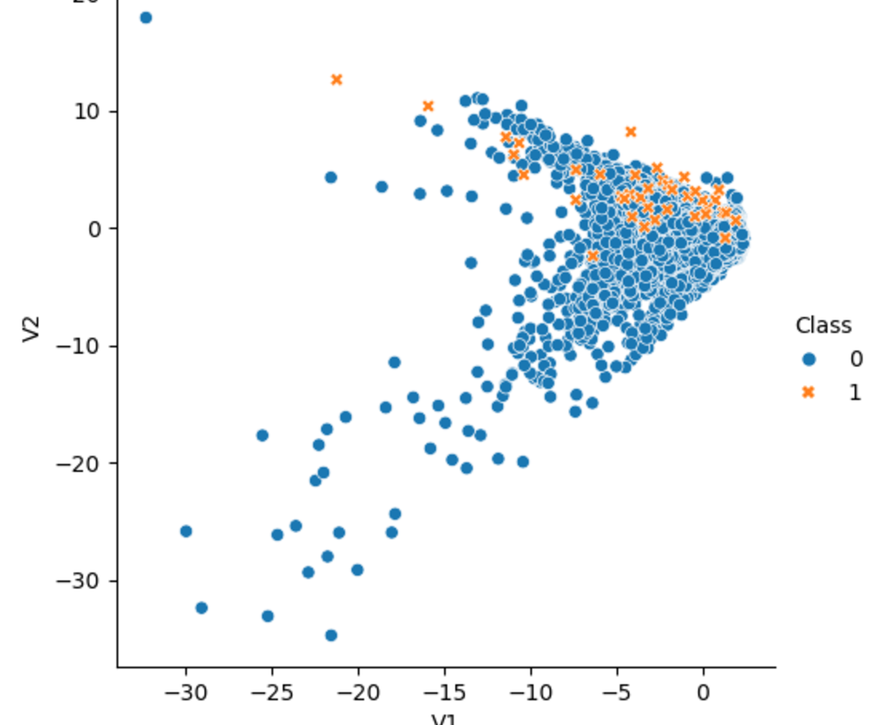
Data
Introduction, Data & Research Question
DABN14-Project 2
Overview:
HELP international
167 countries
10 feature columns
Variables:
Health
Social
Economic
Outliers:
Microstates skew the data!
(Luxembourg, Singapore, Malta)

Slide 6
Introduction, Data & Research Question
DABN14-Project 2
“Can we generate meaningful insights and clusters into the socioeconomic and health-situation of the world's countries, and how do these compare to the clusters made by the human development index?”

Slide 7
Agenda
DABN14-Project 2
1.
Introduction, Data & Research Question
2.
Human Development Index
3.
Models & Theory
4.
Results & Evaluation
5.
Conclusion

Slide 8
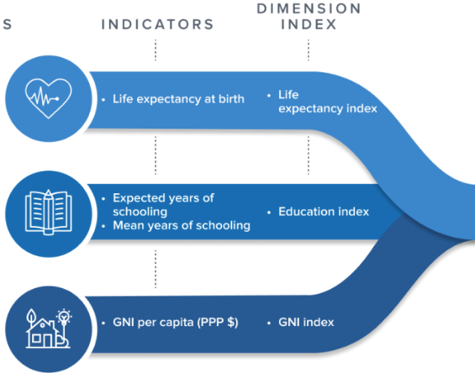
Human Development Index (HDI)
Human Development Index
DABN14-Project 2
Purpose:
Used to question national policy choices
Method:
Assigns countries to groups according to achievements in human development
How we will use it:
Baseline model

Slide 9
Agenda
DABN14-Project 2
1.
Introduction, Data & Research Question
2.
Human Development Index
3.
Models & Theory
4.
Results & Evaluation
5.
Conclusion

Slide 10
Models & Theory
DABN14-Project 2
“K-mean Clustering is a frequently used algorithm to partition data into different clusters based on finding the minimum variation (sum of squares) within groups (or clusters).”

Slide 11
K-means Clustering
Models & Theory
DABN14-Project 2
Optimised algorithm as described by Harting & Wong (1979).
6-step procedure where clusters are determined by transfers of data point based on sum of squares minimisation of clusters.
Improved initialisation by Arthur & Vassilvitskii (2007): The K-Means++.
Chooses random starting centroids, uniformly in the data.

Slide 12
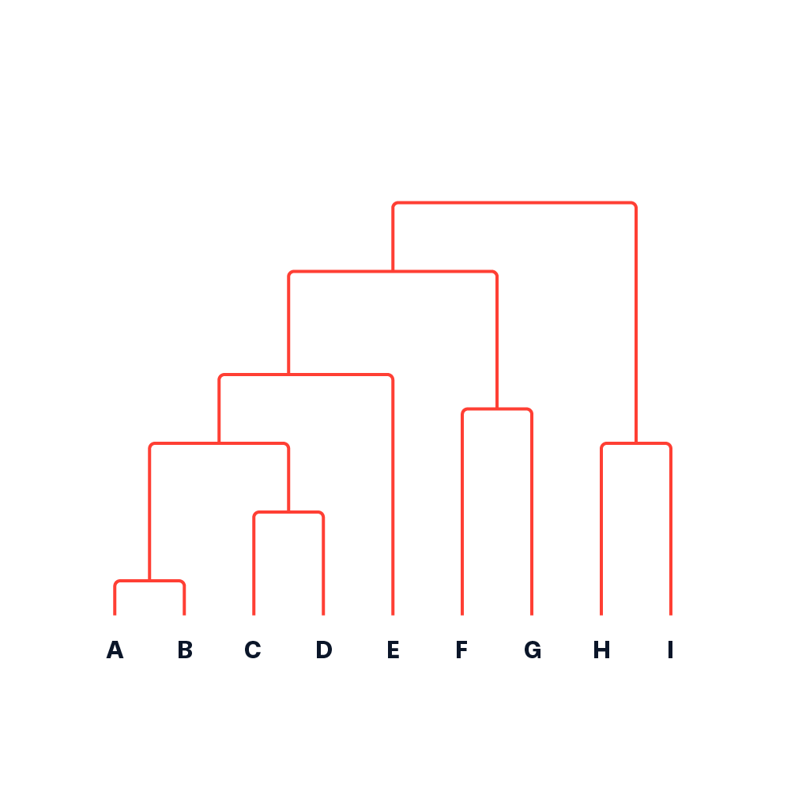
Hierarchical Clustering
Models & Theory
DABN14-Project 2
Divides data into clusters based on some similarity measure (linkage)
Choice of linkage has a dramatic impact on clustering outcome

Slide 13
Adjusted Rand Index
Models & Theory
DABN14-Project 2
Assesses agreement between partitions and is a standard tool in cluster validation.
Counts pairs of objects and adjusts for chance.
Will be calculated in relation to the HDI dataset.

Slide 14
Agenda
DABN14-Project 2
1.
Introduction, Data & Research Question
2.
Human Development Index
3.
Models & Theory
4.
Results & Evaluation
5.
Conclusion

Slide 15
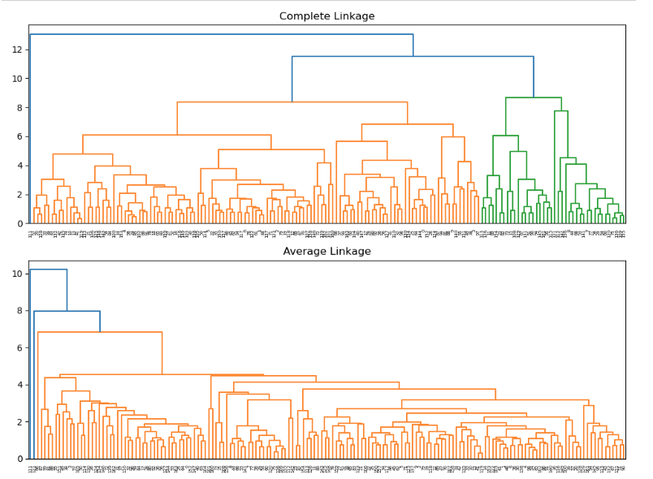
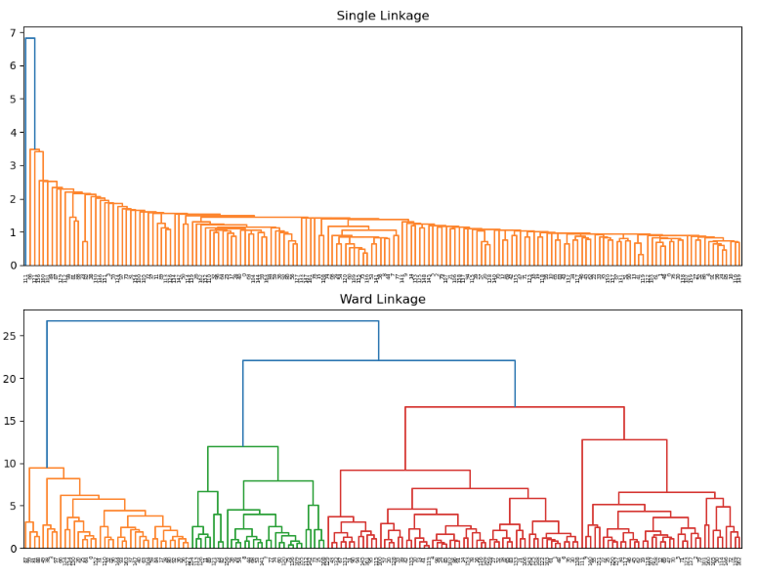
Results & Evaluation
DABN14-Project 2
Hierarchical Clustering Dendograms
Ward linkage at K = 4 was chosen

Slide 16
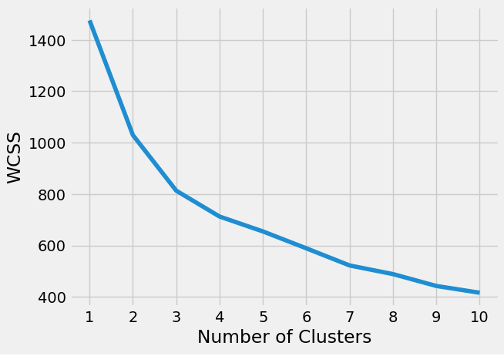

K-means: Optimal number of clusters
Results & Evaluation
DABN14-Project 2
Visualisation of within-cluster sum of squares (WCSS) for different K
Optimal was found at K = 3
K = 4 chosen for comparison with HDI & Hierarchical

Slide 17
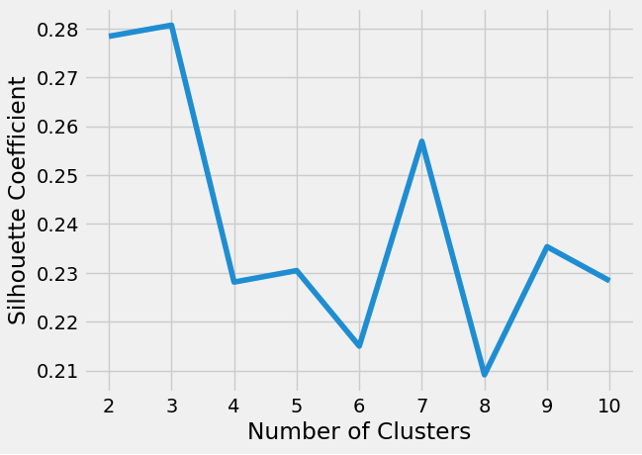
K-means: Optimal number of clusters
Results & Evaluation
DABN14-Project 2
Visualisation of Silhouette Coefficient for different K
Local maximum found at K = 3
K = 4 chosen for comparison with HDI & Hierarchical

Slide 18
Evaluation
Results & Evaluation
DABN14-Project 2
Boxplots in order to compare the feature distribution of the clusters
Maps in order to give a more intuitive sense of the clusters
Adjusted Rand Index score in order to have some point of objective comparison

Slide 19
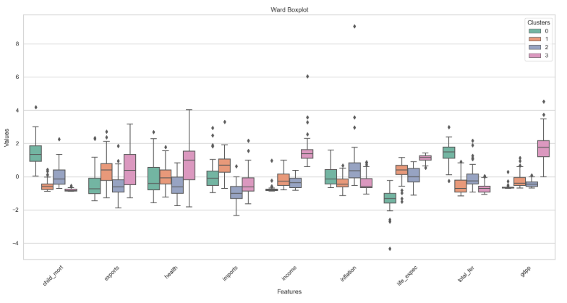
Results & Evaluation
DABN14-Project 2
Boxplot:
Wards Linkage
Distinct clusters in some features
Overlap in others
Similar clusters to K-Means

Slide 20
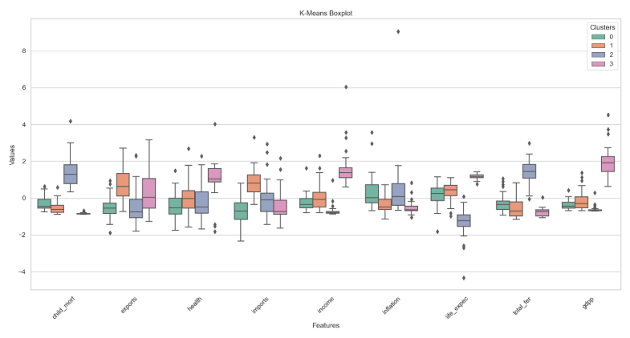
Results & Evaluation
DABN14-Project 2
Boxplot:
K-Means
Distinct clusters in some features
Overlap in others
Similar clusters to K-Means

Slide 21
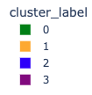

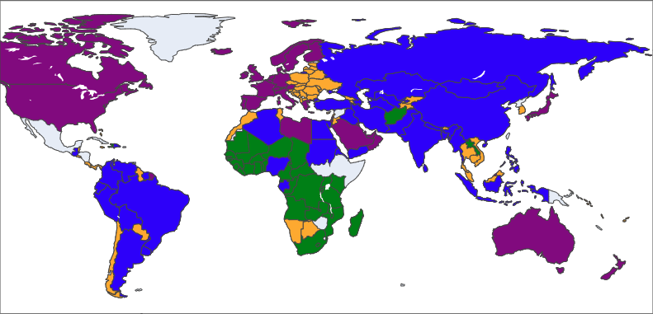
Results & Evaluation
DABN14-Project 2
Map:
Ward linkage
Divided Europe
Asia and South America together
Africa split among all clusters

Slide 22
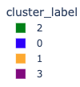

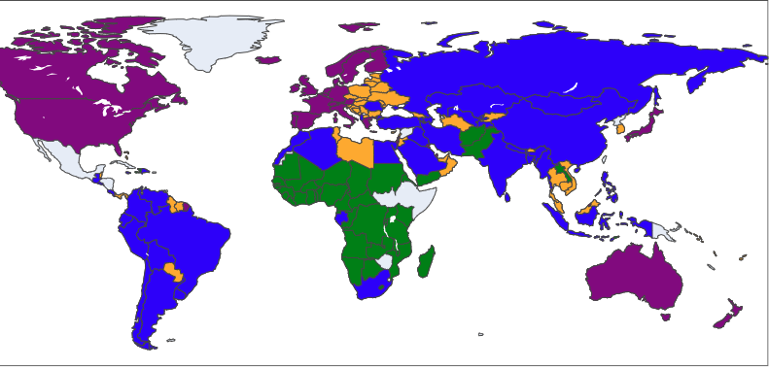
Results & Evaluation
DABN14-Project 2
Map:
K-Means
Divided Europe
Asia and South America together
Africa split

Slide 23


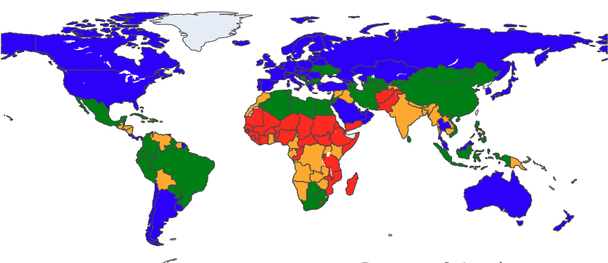
Results & Evaluation
DABN14-Project 2
Map:
Ward
Europe mostly united
Asia and South America similar
Africa heavily divided

Slide 24
Adjusted Rand Index score
Ward
K-Means
Results & Evaluation
DABN14-Project 2
0.8
0.7
0.6
0.5
0.4
Agreement in relation to the HDI dataset
Ward score: 0.257
K-Means score: 0.283
0.3
0.2
0.1
Model F₂-score

Slide 25
Agenda
DABN14-Project 2
1.
Introduction, Data & Research Question
2.
Human Development Index
3.
Models & Theory
4.
Results & Evaluation
5.
Conclusion

Slide 26
Conclusion
Conclusion
DABN14-Project 2
Successful demonstration of clustering methods
Meaningful clusters?
Motivational differences with HDI
Could be expanded with a larger feature set and alternate algorithms in order to inform evidence-based policy decisions.

